Slide 1
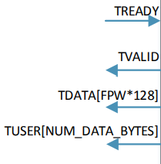
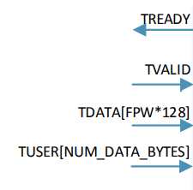
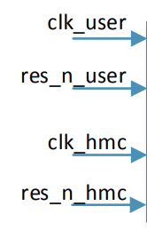
HMC
Controller
phy_data_tx_link2phy
phy_data_rx_phy2link
AXI_Rsp_IF
HMC_Trans_IF
phy_ready
phy_bit_slip
phy_lane_polarity
HMC_Mem_IF
P_RST_N
hmc_LxRXPS
AXI_Req_IF
HMC_IF
hmc_LxTXPS
FERR_N
rf_read_data
rf_invalid_address
rf_access_complete
RF_IF
rf_address
Sys_IF
rf_write_data
rf_write_en
rf_read_en

Slide 2
clk_user
HMC Controller
HMC Controller
rf_read_data
res_n_user
Sys_IF
rf_invalid_address
clk_hmc
RF_IF
rf_access_complete
res_n_hmc
rf_address
rf_write_data
rf_write_en
rf_read_en
HMC Controller
phy_data_tx_link2phy
HMC_Trans_IF
phy_data_rx_phy2link
phy_tx_ready
phy_rx_ready
phy_bit_slip
phy_lane_polarity
P_RST_N
HMC_IF
hmc_LxRXPS
TREADY
HMC Controller
hmc_LxTXPS
TVALID
AXI_Req_IF
FERR_N
TDATA
TUSER
TREADY
HMC Controller
TVALID
AXI_Rsp_IF
TDATA
TUSER

Slide 3
HMC
Controller
AXI Slave
Rsp
Rsp
HMC
Memory
AXI Master
Req
Req

Slide 4
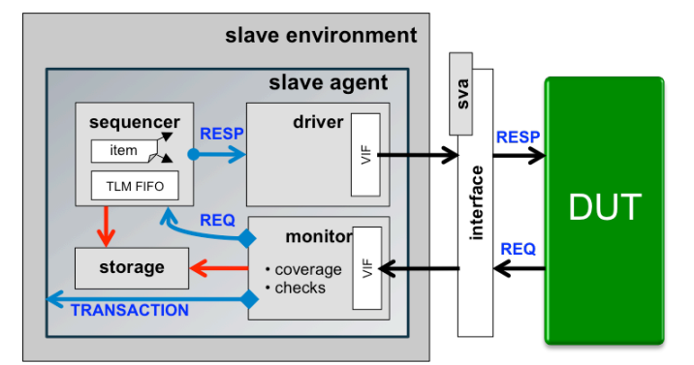
Reactive Agent with Storage :
RESP
REQ
Page(15) MASTERING REACTIVE SLAVES IN UVM paper

Slide 5
System Architecture of HMC Controller :
HMC
Controller
AXI_Rsp_Agent
HMC_Mem_Agent
AXI Slave
Rsp
Rsp
Reactive
agent
AXI_Req_Agent
AXI Master
Req
Req

Slide 6
Top
Test
Env
SCB
FIFO
FIFO
Cov
SCB
SCB
Cov
SCB
Sequences
HMC_Mem_Agent
AXI_Req_Agent
Sys_Agent
AXI_Rsp_Agent
RF_Agent
Sqr
analysis_fifo
Sqr
Sqr
Sqr
Sqr
Storage
Analysis_port
Analysis_port
Analysis_port
Drv
Mon
Drv
Mon
Drv
Mon
Drv
Mon
Drv
Mon
SVA
AXI_Req_IF
Sys_IF
AXI_Rsp_IF
RF_IF
HMC_Mem_IF
DUT
HMC Controller

Slide 7
Teams
HMC Mem Agent
Mohamed Ibrahem
Kholoud Darwesh
AXI Request Agent & AXI Response Agent
Omnia Mohamed
Omnia Salah
Youmna Mohamed
Rana Wagdy
Tarek Emad
Eslam Elfeki
System Agent & Register File Agent
Kholoud Darwesh

